Slide 1
Software Project Management
Lecture 14
Procurement Management

Slide 2
Procurement
Hardware
Software / Software Tools
IT Services
Development
Data Entry
Surveys
Networking
Others: Stationary, Office Space, Transportation, Furniture, etc.

Slide 3
Procurement
The art of buying resources
A formal written process

Slide 4
Procurement
Includes:
Obtaining quotations / bids / proposals
Selecting the vendor
Administering the contract

Slide 5
Finding a Vendor
Your choice in vendor depends on the priorities and requirements of your organization and your stakeholders – but you should also consider:
Risk Tolerance High Risk Tolerance = Can Select New Providers Low Risk Tolerance = Must be Experienced Provider
Cost If cost is big concern than you will look for someone with most offering for your money
Time If time is big concern than you will look for someone who can provide quickly

Slide 6
Finding a Vendor
Process
Send out a Request for Information (RFI)
Set up a Bidders’ Conference
Send a Request for Proposals (RFP)
Review Proposals and make your Final Decision

Slide 7
Request for Information (RFI)
In the RFI, you present your wish list, which details your best-case scenario of what you’ll need.
In addition to basic questions about price and cost, your RFI may contain the following list of questions:
The software testing application must integrate with the development database residing on our on-site servers.
Is any specialized hardware required on our end?
How long has your company been providing application-testing services?
What are the general qualifications of the personnel who would be providing software-testing services?
Can you perform the software testing on-site, or do we have to come to you?

Slide 8
Bidders’ Conference
Bidders’ Conference is a meeting where you and potential bidders sit around and discuss your requirements and vendors’ offerings:
Outlines your agenda and highlights specific areas that you would like the vendors to address
Include team members & other stakeholders
Vendors may have questions for you to clarify your requirements and wishes

Slide 9
Bidders’ Conference
Maintain control over the meeting (don’t let a vendor take over the control), Watch out if a vendor is exaggerating
Ensure vendors understand your requirements correctly
Make notes of differences between the offerings

Slide 10
Request for Proposals (RFP)
A Request for Proposals (RFP) is your request for various vendors to provide their proposals
In the RFP, you specify exactly what you want vendors to supply
You also provide the logistical and service requirements

Slide 11
Request for Proposals (RFP)
Logistical Requirements are the delivery and installation timelines for any equipment and products
Service Requirements are contracts concerning warranties, maintenance, and upgrades after any warranties expire

Slide 12
Request for Proposals (RFP)
Evaluate all proposals carefully - because the offerings in the proposal become incorporated in the contract.
Proposals are most likely to differ from what vendors’ claimed in response to RFI or in the bidder’s conference.

Slide 13
Selecting the Vendor
Usually all the vendors handle the big stuff - the main items that you want to purchase.
Only the details differ, and these details (and the differences) can make or break the proposal.

Slide 14
Selecting the Vendor
Considering market conditions Is it buyer's market or seller’s market?
Use screening system Sort through all the ins and outs of the proposals – compare the details
Use Team Members' Help Consider making an evaluation committee

Slide 15
Weighting System:
A weighting system takes out the personal preferences of the decision-maker in the organization to ensure that the best seller is awarded the contract.
Weights are assigned to the values of the proposals and each proposal is scored.
Because the weights are determined before reviewing the proposals, the process is guaranteed to be free of personal preferences and bias.
The seller with the highest score is awarded the contract

Slide 16
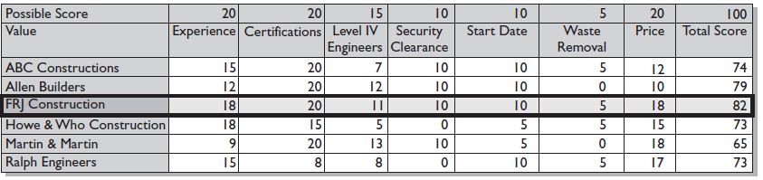
Weighting System:

Slide 17
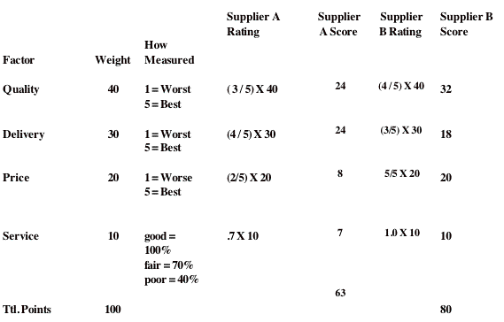
Weighting System:

Slide 18
Negotiating
You have to negotiate the final contract
Price
Iron Triangle

Slide 19
Negotiating
Timelines and benchmarks
Include penalties for not meeting targets
How much support in manpower and equipment you need
Other resources with costs are accounted for in writing (delivery cost)

Slide 20
Contract
Sometimes, and not usually intentionally, the terms agreed to in writing don’t match what was discussed and agreed to orally - The written terms almost always win in any contract dispute.
If your company has a legal department, have one of its representatives review the contract first and alert you of any potential problems and help you negotiate the terms if necessary.
The type of contract you negotiate determines whether you bear most of the risk or whether the vendor bears most of the risk.

Slide 21
Contract Types
Fixed Price Contracts
Time and Materials

Slide 22
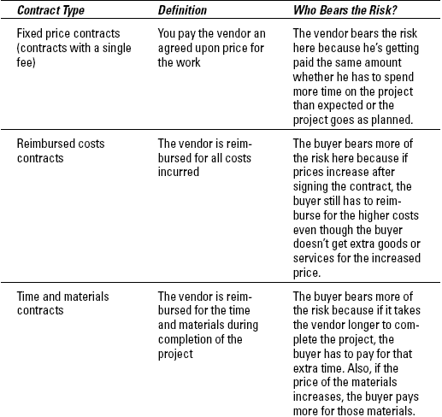
Contract Types

Slide 23
Terms and Conditions
Terms and conditions are the details of a contract that define every aspect of its implementation and how its requirements on all parties are performed.
The terms and conditions don’t so much cover what you are buying, but address the issues surrounding your purchase

Slide 24
Terms and Conditions
Free On Board (FOB) point The place where delivery is considered to occur
Payment terms Advance, Graduated, Delivery / Completion
Extraneous work and materials Work that’s not included in the product purchase unless otherwise specified

Slide 25
Q & A

